Slide 1

Neural Network – Deep Learning – Matlab
By Ahmed Elhelow

Slide 2
Convolutional Neural Network
what CNN does is, it extract the feature of image and convert it into lower dimension without loosing its characteristics
Suppose initial the size of the image is 224 x 224 x 3
Without convolution then you need 224 x 224 x 3 = 100352 numbers of neurons in input layer
After applying convolution you input tensor dimension is reduced to 1 x 1 x 1000
Only need 1000 neurons in first layer of feedforward neural network

Slide 3
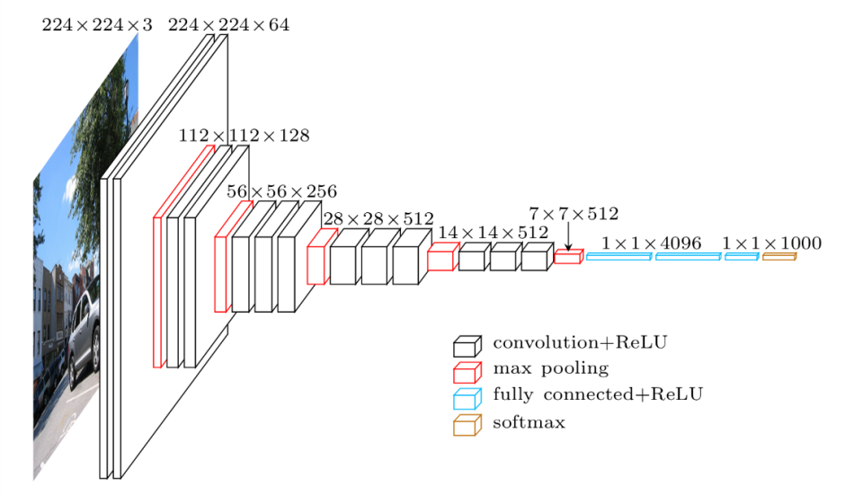
Convolutional Neural Network

Slide 4
Filters
Convolution operation is used with some filters for detecting edges
Suppose gray scale image with dimension 6 x 6 and filter of dimension 3 x 3
When 6 x 6 grey scale image convolve with 3 x 3 filter, we get 4 x 4 image
First, 3 x 3 filter matrix get multiplied with first 3 x 3 size of our grey scale image
We shift one column right up to end , after that we shift one row and so on

Slide 5
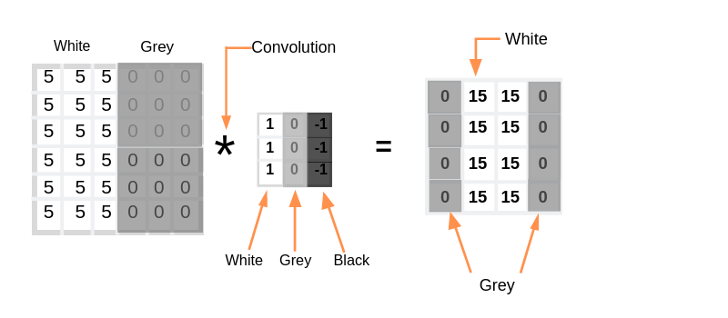
Filters

Slide 6
Stride
Stride denotes how many steps we are moving in each steps in convolution
By default it is one

Slide 7
Padding
Notice that the size of output is smaller that input
To maintain the dimension of output as in input, we use padding
Padding is a process of adding zeros to the input matrix symmetrically
The extra grey blocks denote the padding

Slide 8
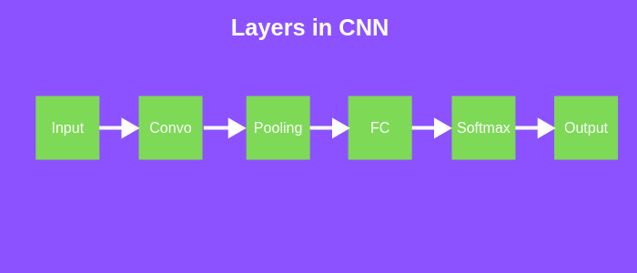
Layers in CNN
There are five different layers in CNN
Input layer
Convo layer (Convo + ReLU)
Pooling layer
Fully connected(FC) layer
Softmax/logistic layer
Output layer

Slide 9
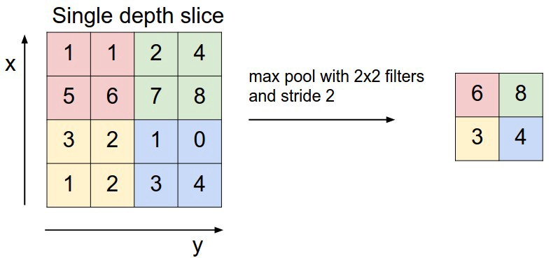
Pooling Layer
Pooling layer is used to reduce the spatial volume of input image after convolution
It is used between two convolution layer
Applying FC after Convo layer without pooling is computationally expensive
The max pooling is only way to reduce the spatial volume of input image

Slide 10
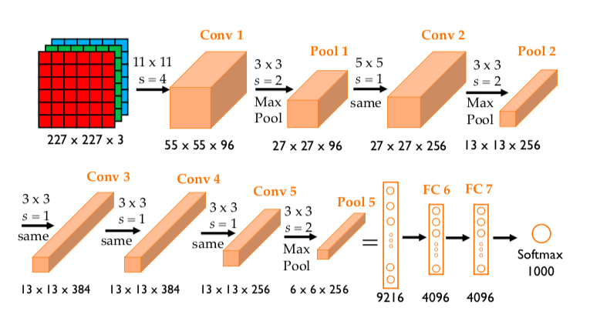
AlexNet

Slide 11
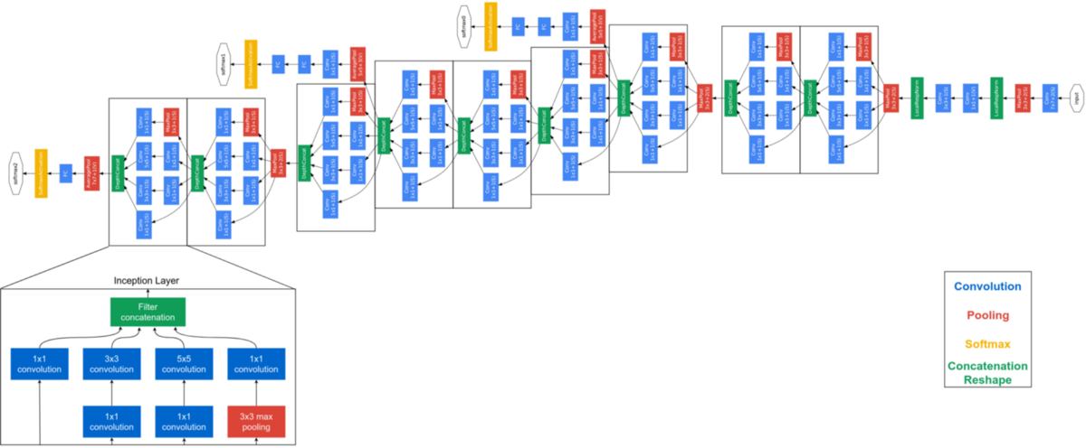
GoogLeNet

Slide 12
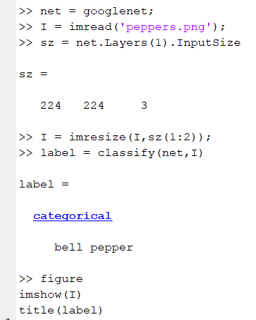
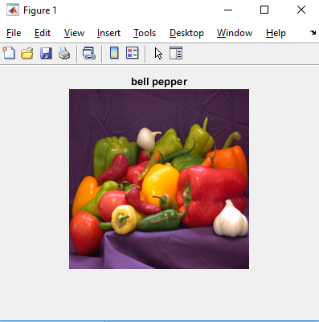
GoogLeNet

Slide 13
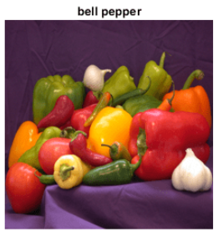
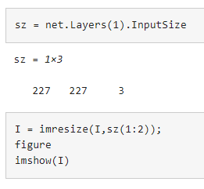
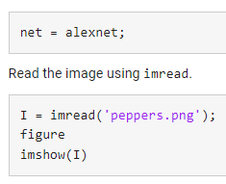
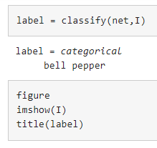
AlexNet

Slide 14
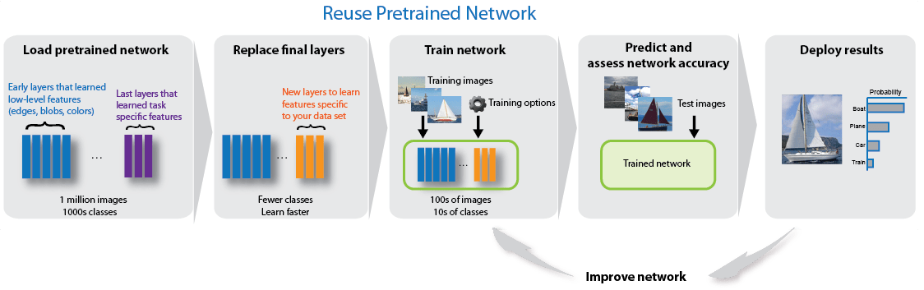
AlexNet – Transfer Learning

Slide 15
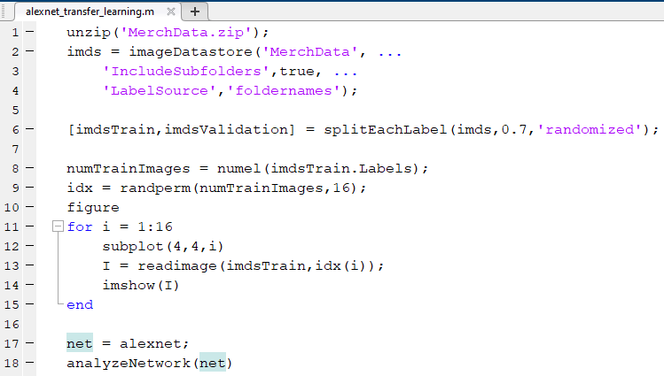
AlexNet – Transfer Learning

Slide 16
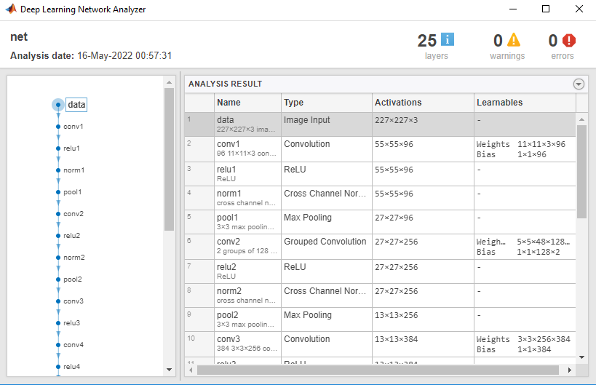
AlexNet – Transfer Learning

Slide 17
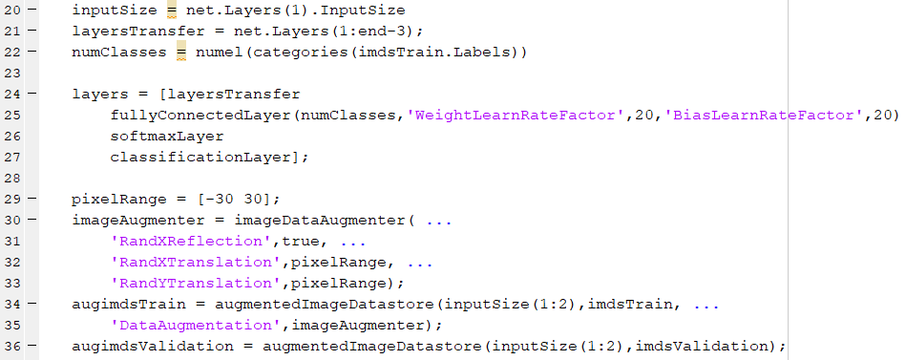
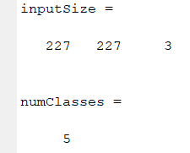
AlexNet – Transfer Learning

Slide 18
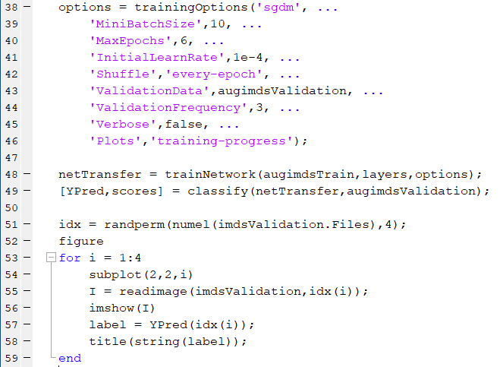
AlexNet – Transfer Learning

Slide 19
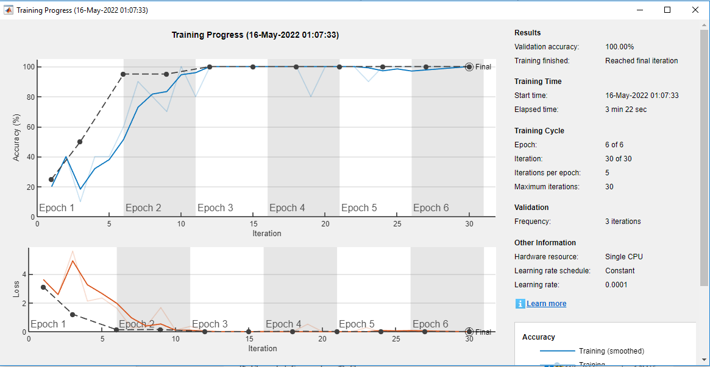
AlexNet – Transfer Learning

Slide 20
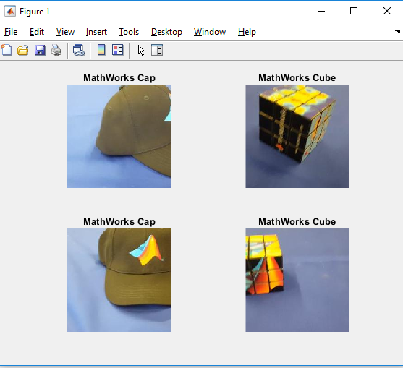
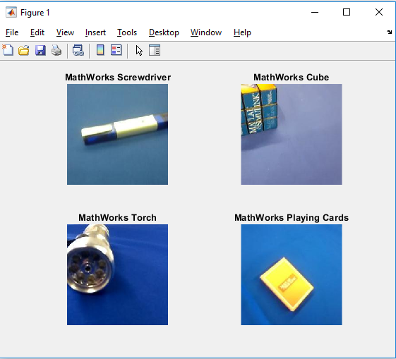
AlexNet – Transfer Learning

Slide 21
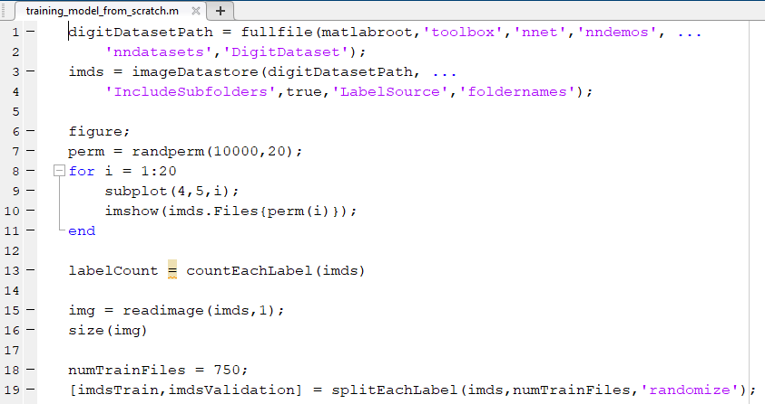
Training a Model from Scratch

Slide 22
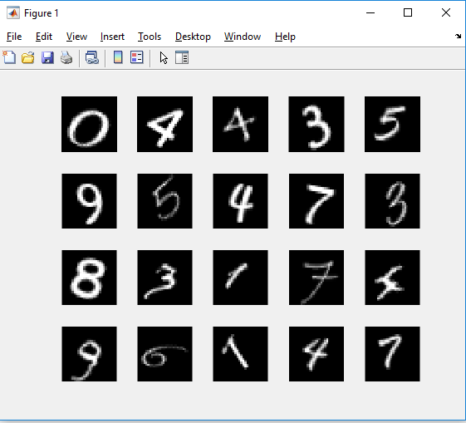
Training a Model from Scratch

Slide 23
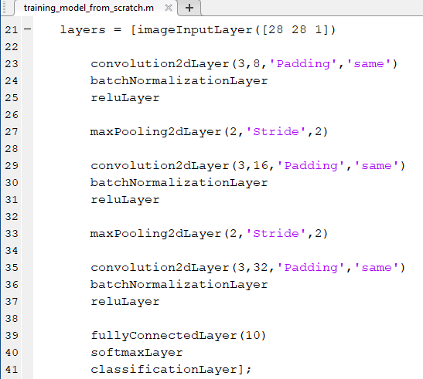
Training a Model from Scratch

Slide 24
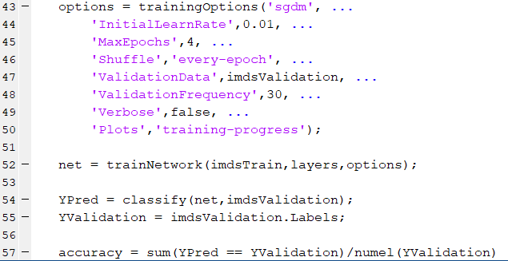
Training a Model from Scratch

Slide 25
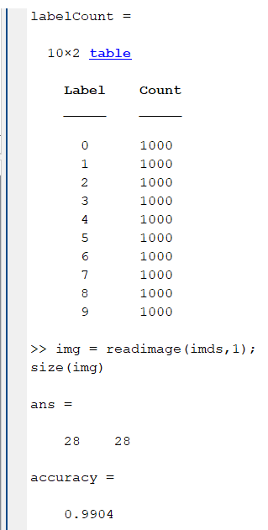
Training a Model from Scratch

Slide 26
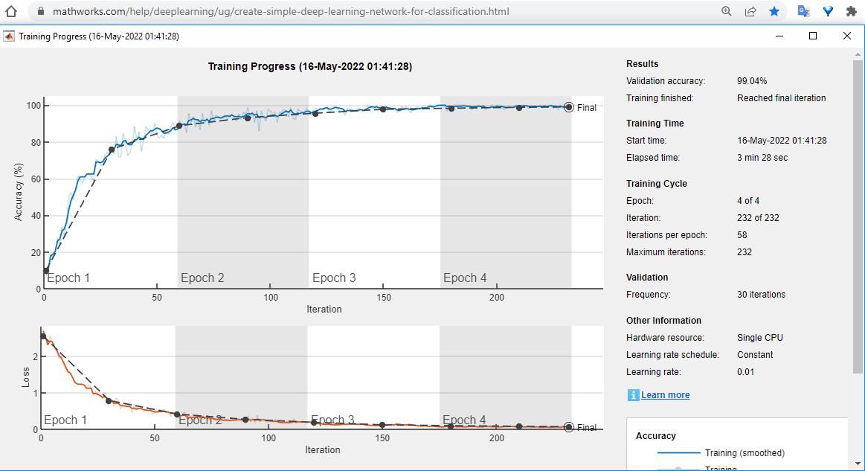
Training a Model from Scratch

